Slide 1
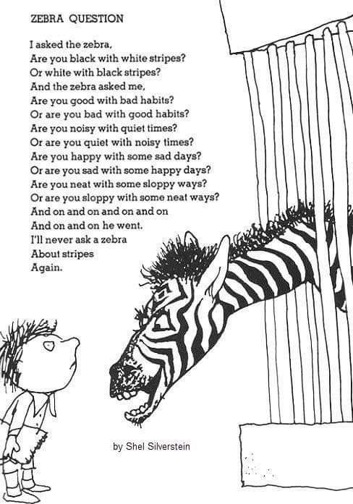
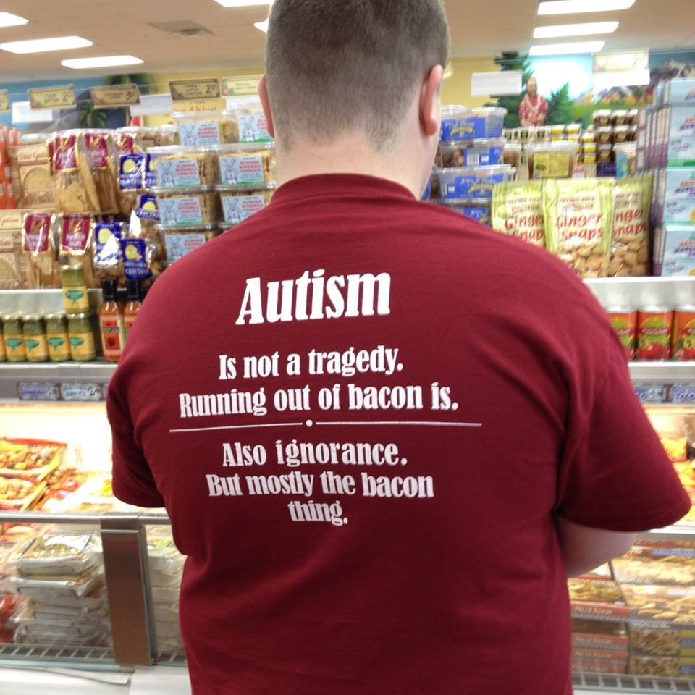
Are you “autistic” or are you “a person with autism”?"
yes. now please pass the ketchup.

Slide 2
Autism
First described: early 1900s.
Offshoot of schizophrenia
1970s: “Developmental disabilities”
(this is where I come in)
Schools (70s/80s)
1) interfered with academics
2) socially disruptive
Kids I knew in school that did have autistic characteristics were drugged into submission -we called them zombies.
Or they were kept in separate classrooms/closet away from the normal kids

Slide 3
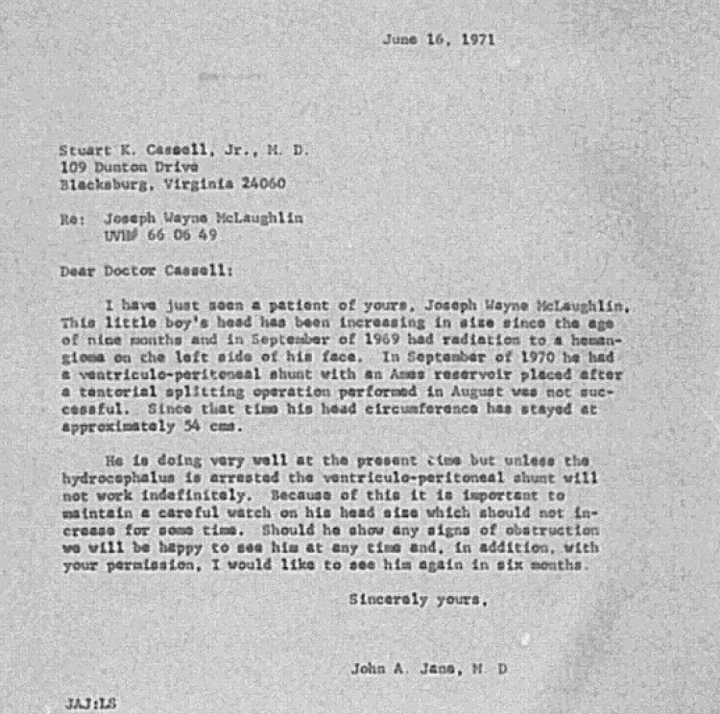
Joseph McLaughlin
As an infant – hydrocephalus - water on the brain
Autism had just been separated from Schizophrenia
typically, only diagnosed in school age adolescents
Usually ANY other condition was tagged before being labeled autistic
Undiagnosed autistic adults were:
  Leaders and innovators in the field
  Nerds who stayed at their desk
  People who refuse to follow the program
  Institutionalized
  Hot heads that no one wanted around
  Still treated as schizophrenia or some other mental disease
  End up with poor/illegal/addictive coping mechanisms
  “loser”
We all have some of those people. This IS my family tree.

Slide 4
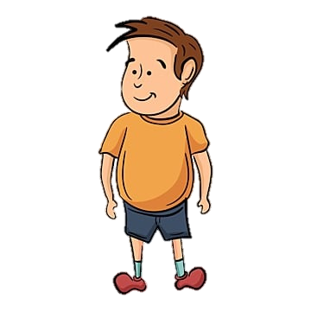


You aren’t different!
You are just trying to be different!
Why are you so different?

Slide 5



Bands
Church
School
Clubs
Parties
Hanging with friends

Slide 6
Spent 40+ years thinking I was broken
In my 40s, family members started showing up with my “unique” characteristics
Hydrocephalus is non-transferable
Diagnosed in my 50s for work related purposes

Slide 7
Hinderances to diagnosis:
  Unawareness - what it is
  Negative stigmas
  Masked by other conditions
    was better to be labeled as brain damaged
    than autistic
  School budget restraints
  Various Socio-economic hinderance

Slide 8
In communicating with people, realize:
Most People Don’t Know What Autism Is
Behavior?
  Why do they gravitate towards abstract and schematic, the absurd and the eccentric.
  Why are they aloof and detached from their environment,
  What’s wrong with their motor skills, their speech, and their facial expressions?
Meltdowns
  Were they temper tantrums?
  Were they psychotic outbreaks?
  Were we supposed to rationalize with people melting down? Spank them? Constrain them? Lock them away? Punish them? Scream them into submission? Ignore them?
Simply saying “they are autistic” lets people decide what it means (usually erroneously)
Instead: Let people know specifics:
  don’t like loud noises
  don’t like moving things
  easily distracted
  like to randomly break out singing Hamilton songs

Slide 9
It is a hidden disability that has only been recognized for around 120 year
Only until recently we have had the tools to understand how it works
The brain itself does not vary significant in appearance than a non-autistic brain
-slight grey matter discrepancies
It wasn’t until the 1990s that they started using tools like MRI and CAT scans to see how the brain works differently
it appears to be primarily in the wiring.

Slide 10
Autism is NOT increasing:
(with the exception that some of our traits are being found beneficial, so we are having more kids)
It is constantly being redefined, moving from
  Schizophrenia
  Autism/PPD-NOS/Aspergers/etc
  Autism Spectrum
A growing awareness beyond simply “a mental deficiency”
As social stigmas are being addressed, people are less likely to eschew a diagnosis.
it’s “less negative” than it used to be.

Slide 11
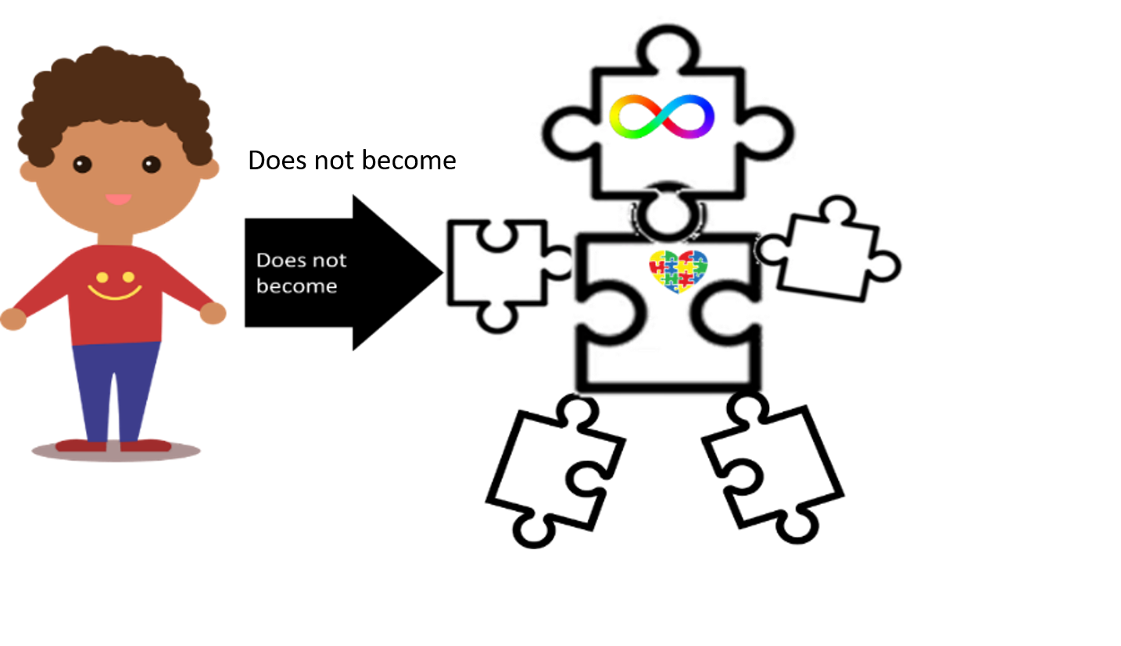
Diagnosis/labels do not change who I am
Medicine and therapy doesn’t mean we’ve failed
It simply means I have technical terms to describe what is going on
and a working paradigm to help me develop healthy coping mechanism

Slide 12
It means that I understand who I am
And that I’m not simply broken

Slide 13
How it works

Slide 14
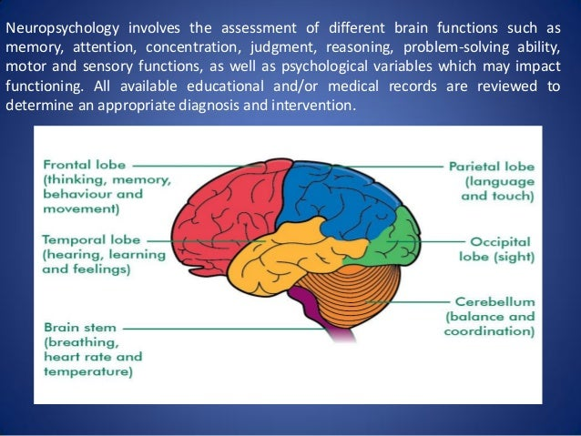
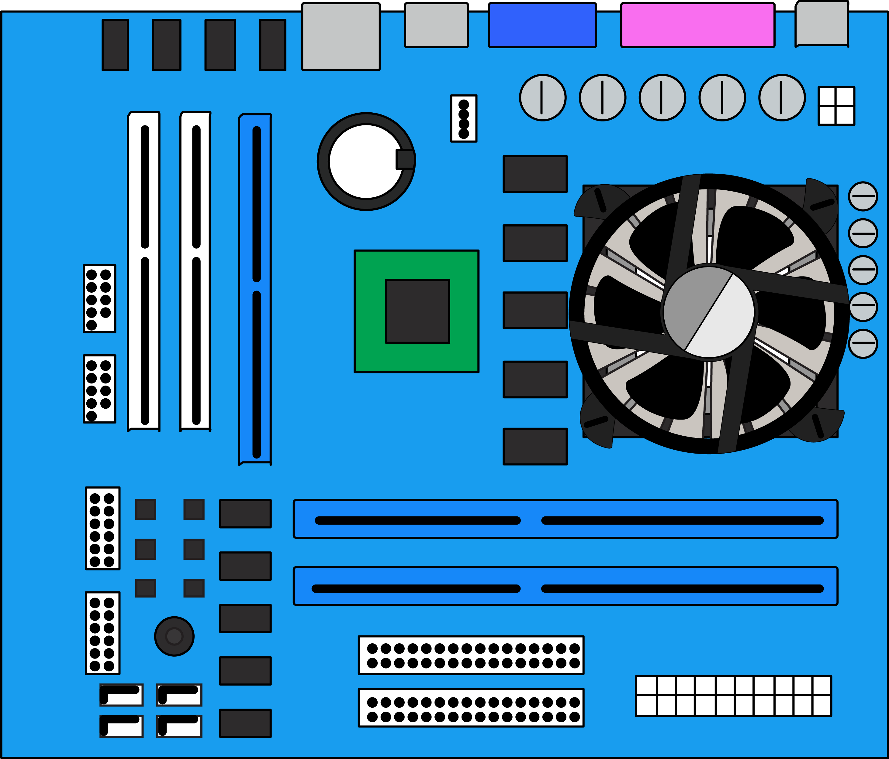
Brain Filters
How the Brain Works
  Controlling the amount of signals
  Directing signals where to go.

Slide 15
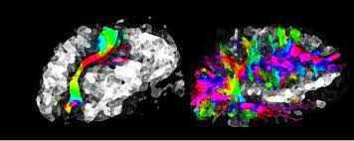
Where the signals go
Aka “Channeling”
Expected
A
B

Slide 16
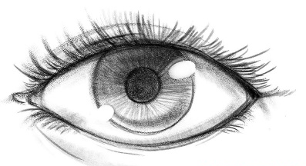



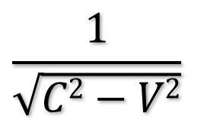
Where the signals go
A
B
Aka “Channeling”
Optic Processor
Sad Event
Area(s) where “sadness” is processed
$$\frac{1}{\sqrt{C2−V2}}$$
Area(s) where math is stored
Something
Implied
Area(s) where “implied” is processed
Internal calendar
Notes:
An example of this is a typical person looking at something: it goes into the eye, and then the brain channels that signal to the optic processor (Occipital lobe)

Slide 17

Filtering the signals
Aka “Gating”
Gate
Input
Processor

Slide 18

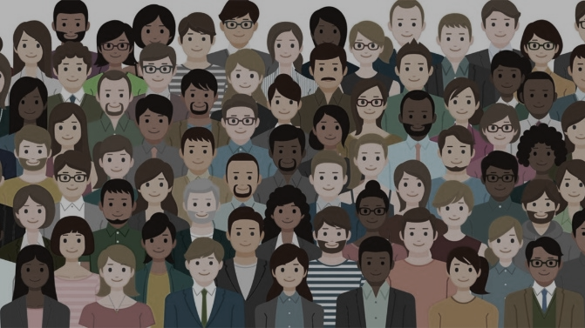


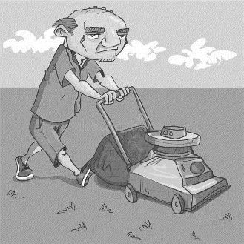
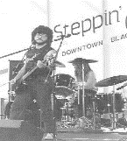


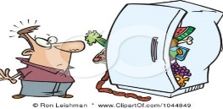


Filtering the signals
Aka “Gating”
Filtered out noises
Hi. I’m Bob
Notes:
When a person is looking for someone or something, the brain typically filters out exterior “noise”, like other people, motion, etc. The same with sound: if someone is talking to us, the brain will mute out as much of the exterior noises as possible.
With my filters, I cannot do that: I see everything at once. One big faceless blur of visual chaos. My wife has to wave me down, even when she is standing right in front of me.
I hear everything at the same volume – air conditioners, fans, TV, other people talking, etc. and my brain literally tries to communicate with all of it. So I get lost when someone is talking to me. Their voice literally blends in to the rest of the noise, and I can’t understand their words.

Slide 19
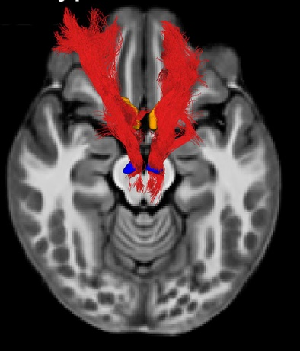

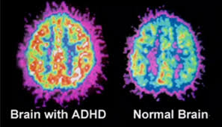
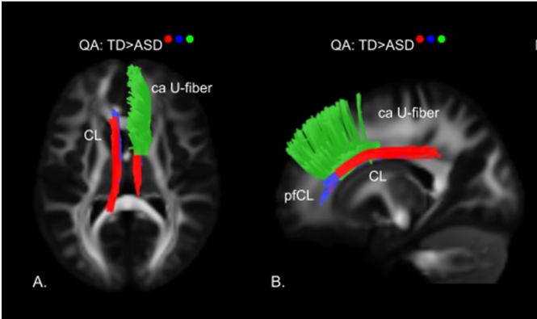

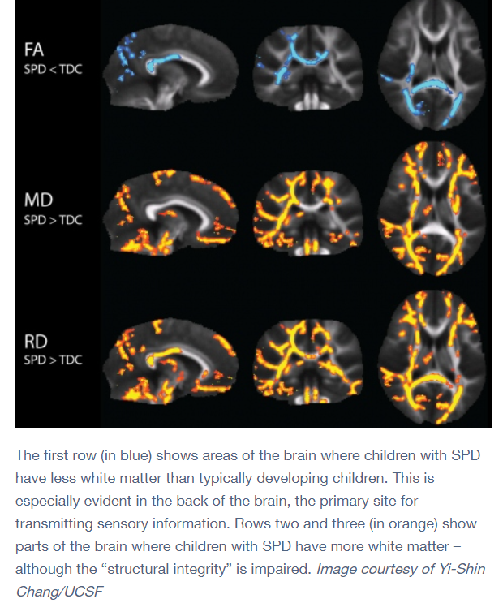
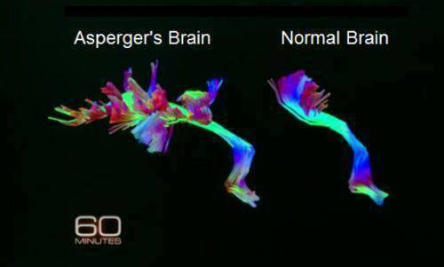
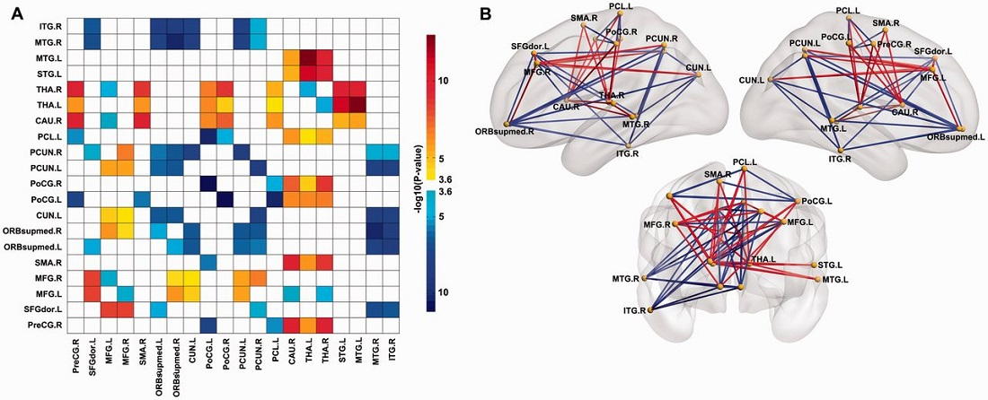
atypical
typical
There is no definitive line between all the unique spectrum variants.
Each person experiences there own unique design.
Hence, the term “Spectrum” is used.
There is no “little bit autistic”.

Slide 20
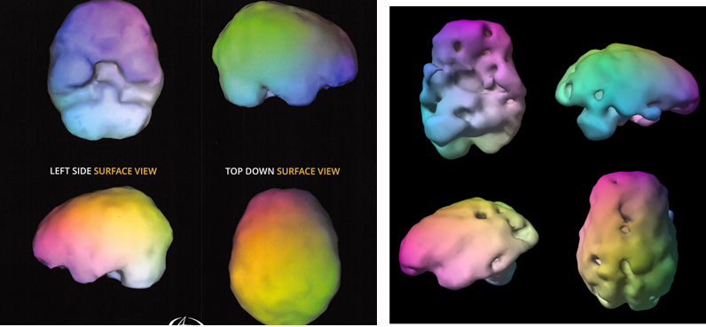
Some people who experience
  trauma,
  mental health issues like dementia or schizophrenia,
  “brain conditioning”
will experience many of the things mentioned on various levels.
People like me have experienced these things all our lives.
It’s the way we process the world since birth.
Think: difference between person born blind
and the person born with sight and then lose their sight
via “life events”

Slide 21
Augmentation 1: Deviated signals, where the signals are sent outside the expected receiver
What my brain is doing
(Deviating)
What I expect my brain to do (Channel)
A’
A
A’
A
B
Q
Notes:
And deviations in the filter will cause the brain to send signals to the wrong spot. (I will literally feel what I smell, words and textures may trigger sensory issues, etc)

Slide 22
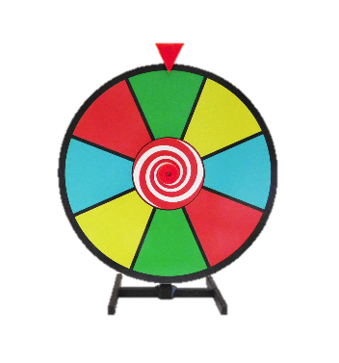




Channeling
I hear and see a spinning wheel.
My joints itch
My knee just gave out
Spin
Click
Optic Processor
“Hello”
Signal may cause my entire body to tingle and completely consume the individual
I lose my balance and the room start to spin
Optic Processor says “see green”
auditory Processor
Notes:
An example of this is a typical person looking at something: it goes into the eye, and then the brain channels that signal to the optic processor (Occipital lobe)

Slide 23
Treated with Stimulants
Prescribed: Ritalin, Focalin
Self-medicated: Caffeine, pseudoephedrine
“it helps put everything together/make sense”
A’
A
B
Theoretically: encouraging the parts of the brain we use to sort and organize data
What it's not doing: telling the signals where to go.
IT DOES NOT FIX IT
Q
Notes:
And deviations in the filter will cause the brain to send signals to the wrong spot. (I will literally feel what I smell, words and textures may trigger sensory issues, etc)

Slide 24
Augmentation 2: overload – not controlling signals the amount of signals
What my brain is expected to do (Gated)
A
A’
What my brain is doing (overloaded)
A
A’

Slide 25





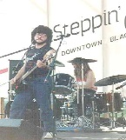
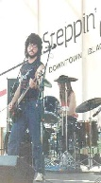
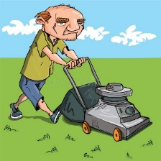



Gating
?
Hi. I’m Bob
Filtered out noises
Notes:
When a person is looking for someone or something, the brain typically filters out exterior “noise”, like other people, motion, etc. The same with sound: if someone is talking to us, the brain will mute out as much of the exterior noises as possible.
With my filters, I cannot do that: I see everything at once. One big faceless blur of visual chaos. My wife has to wave me down, even when she is standing right in front of me.
I hear everything at the same volume – air conditioners, fans, TV, other people talking, etc. and my brain literally tries to communicate with all of it. So I get lost when someone is talking to me. Their voice literally blends in to the rest of the noise, and I can’t understand their words.

Slide 26
A
A’
Treated with anti-psychotics
Prescribed: Abilify, Haldol, Latuda
Self-medication: anything that “helps relax/reduce anxiety” that is not a stimulant
(“it cuts out all the noise”)
Theoretically: reducing the chemicals that transport signals in the brain
Not doing: telling signals where to go or which signals to weed out.
IT DOES NOT FIX IT
A
A’

Slide 27
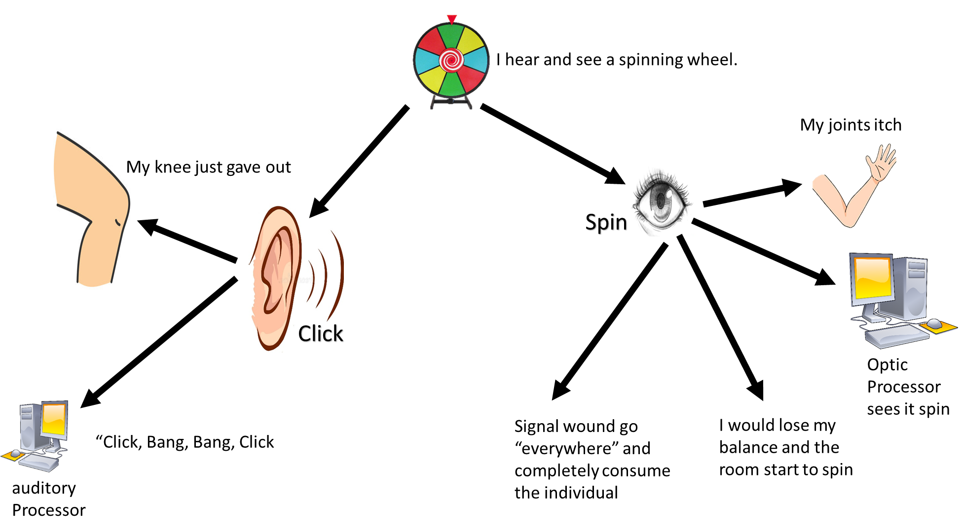
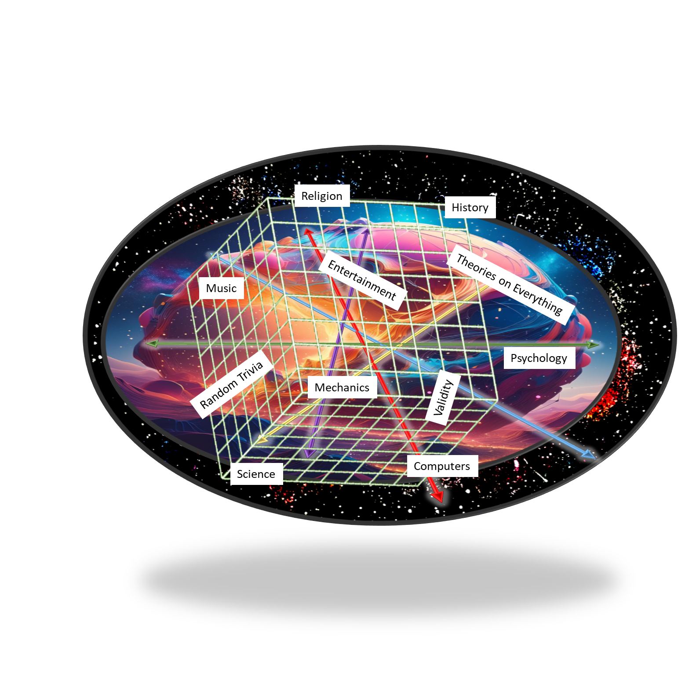

Big flag
I don’t understand why I am so overwhelmed! (“I would do anything to fix this”)
Still experiencing this in my 40s in a job that fits me & I loved.

Slide 28



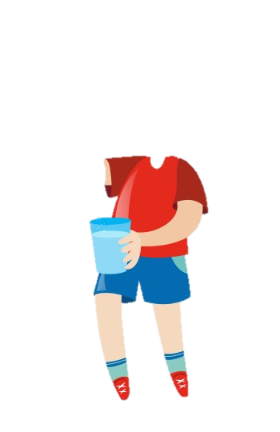
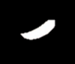

Filtering the signals

Slide 29
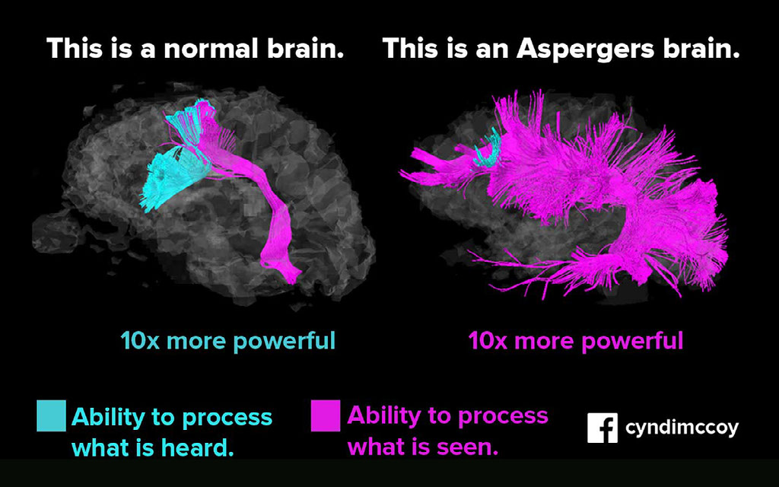


Slide 30

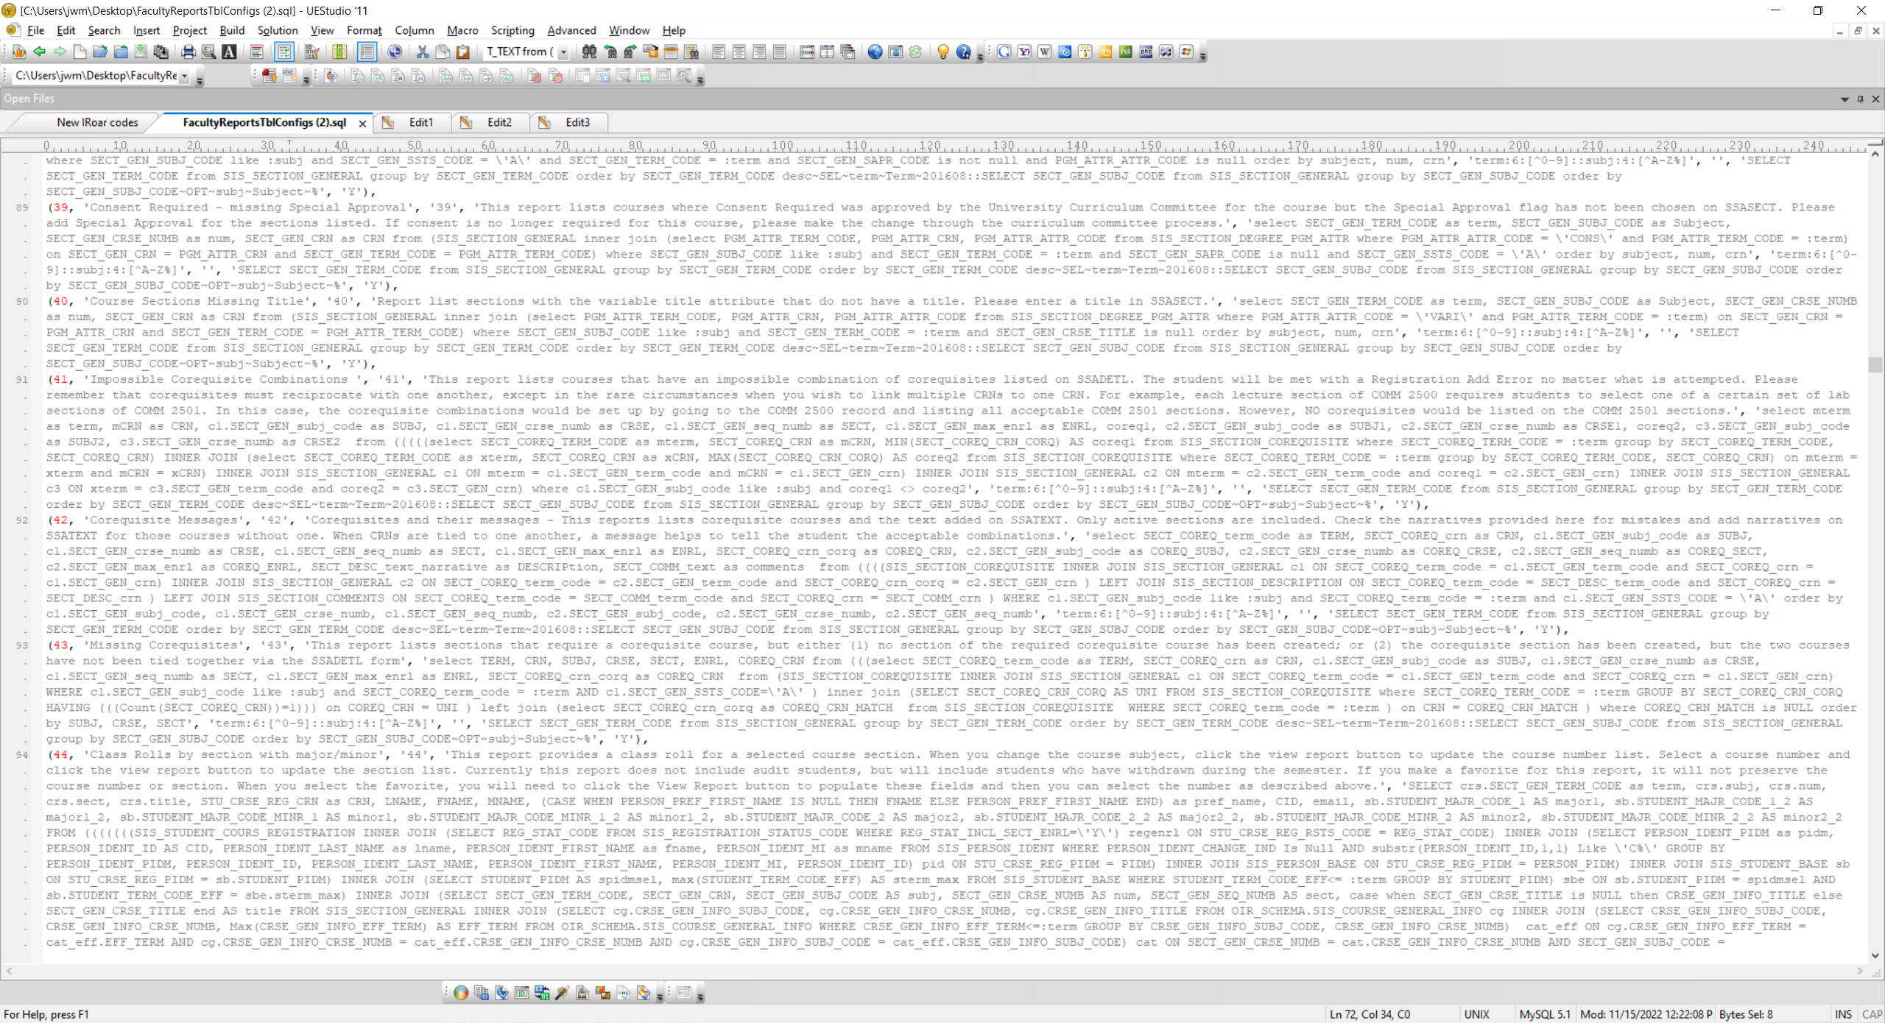
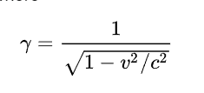
Like tears in the rain
Metallica vs Chopin
Don’t forget your towel
Ugarit influence in ancient Mesopotamia
HR Pufnstuf
Mixolydian vs Locrian
Milli Vanilli

Slide 31
Literally speaking, this is programming.
It is not “conditional” or “chemical”.
It is not “Learned behavior”.
You cannot “unautism” someone.
It is not a “deficit”, it is “different”.

Slide 32
Meltdowns/overloads

Slide 33
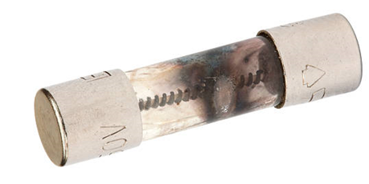
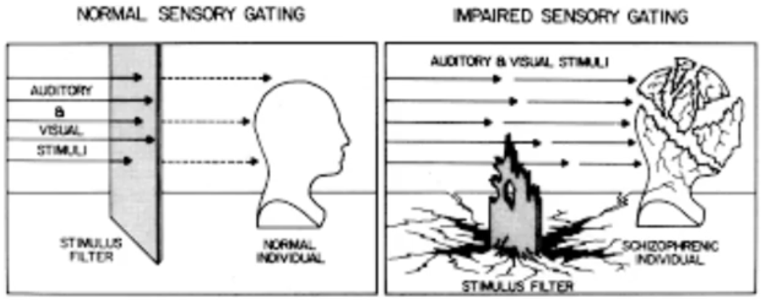
A “Meltdown” is the brain’s response to being overloaded.
Less “temper tantrums” and more "blown fuse"
--> defense mode:
- Think “Triggered into fight or flight” mode.
Temper tantrums/anger/anxiety can lead to a melt down, but not reverse
    - Think "we are adding these things to an already overloaded system, not extracting them"
Meltdowns are not always provoked.

Slide 34
Meltdowns/overloads aren’t always
“screaming and yelling”
Disorientation,
Rage,
Shutdowns (socially more acceptable, but internally destructive),
Running Away,
Hiding,
Anything that the brain can try to use to defend itself.

Slide 35
Overloads: what we can’t do
Defense mode is NEVER rational. It is only looking for a means to alleviate the threat.
“additional external threats” do not work (yelling, anger, grounding, threat of punishment, etc)

Slide 36
Spanking: sometimes it "works" but not for the reason we think it does. it affects their sensory processes. This can lead to unhealthy coping mechanisms. (self-inflicting)
What you scream at us in the chaos
We will repeat to ourselves in the silence
Sometimes we will get it wrong. It doesn’t mean we should quit.
The very fact we respond comes out of the fact that we care.

Slide 37

Meltdowns: what we MUST do
Even in “fight or flight” mode, we can learn what the acceptable boundaries are.
A child who doesn’t understand the boundaries will become an adult who doesn’t understand the boundaries
I need to learn to “crash my truck” without destroying things, people or opportunities

Slide 38
WE CANNOT FIX IT
I have to learn what I am doing
I have to learn how to manage it
USING HEALTHY COPING MECHANISMS

Slide 39
II
Finally, brothers and sisters, whatever is true, whatever is noble, whatever is right, whatever is pure, whatever is lovely, whatever is admirable—if anything is excellent or praiseworthy—think about such things.
Philippians 4:8

Slide 40
Meltdowns: boundaries
We must decide/learn what is acceptable and unacceptable:
Yelling: OK.
Being verbally abusive: Not ok.
Jumping up and down: OK.
Breaking things: not ok.
Moving around: OK
Hitting people: not ok
These things have to be taught when they are calm
and reinforced when they melt down/overloaded

Slide 41
Meltdowns: boundaries
It is also important to see how our actions affect others:
if it is making someone cry, we need to understand...
If it makes someone uncomfortable, we need to understand ...
If we break something, we don’t get a new one/we have to pay for it.
We need to understand the cost of our meltdown and how we express it.

Slide 42
WHAT IS OUR GOAL
Goes for:
Medicine
Meltdowns
Behavioral issues
Discipline
Therapy
Education
…

Slide 43
?
Individual desiring
self-affirmation
Families who are exasperated
I don’t get to decide your narrative

Slide 44
First note:
What helps you may hurt someone else
What hurts you may help someone else
An organization you hate may be a blessing in disguise for someone else
We are all different with different struggles.
There are individuals and/or family members who are overburdened and would do anything to have something “fixed”, so don’t be mad or impatient at them for trying.
Do not become intolerant of others on the spectrum and the solutions/conclusions they come to.

Slide 45
WHAT IS OUR GOAL
NOT:
  Trying to make us like everyone else
  Trying to make us fit into a box
  Make sure we do things like everyone else
  Taking obstacles completely away
We are not trying to hide or take away our autistic traits!

Slide 46
GOAL
Any goal:
  maximize the things that make us unique.
    Especially the obscure and unexplored
  learning to navigate environments.
    Turn the environment into a tool vs the environment as the enemy/oppressive system
  Know how to address our deficiencies, and if possible,
  turn them into strengths or tools

Slide 47

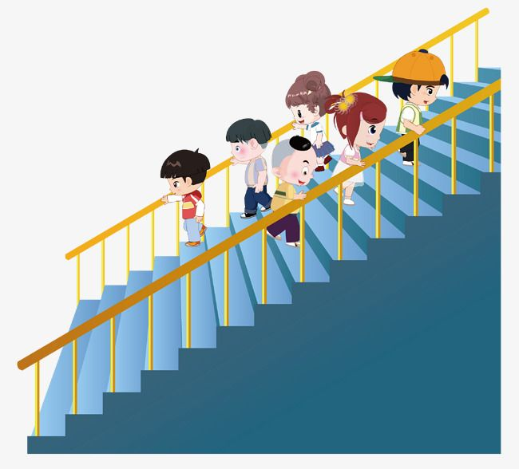
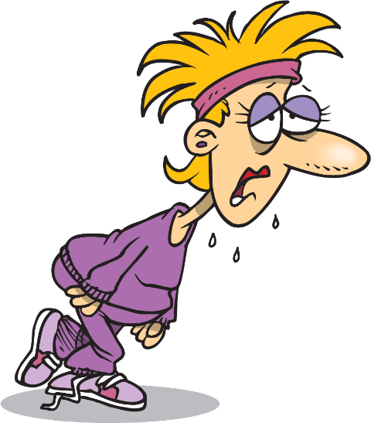
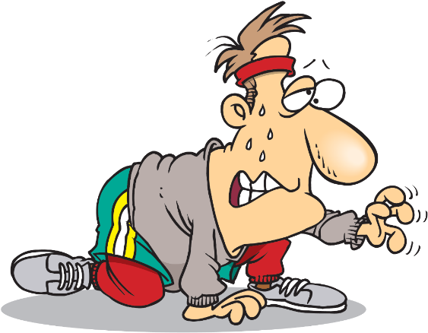
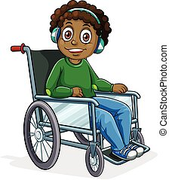
There is a difference between having issues doing something and not being able to do it.
You can’t uncondition someone out of it,
People shouldn't be punished for it.
“Coping Skills and Accommodate”

Slide 48

The Ever On-going balancing act
Accommodate
Overcome
Sometimes there will be things we cannot do,
and we can't expect others to suffer because we can't

Slide 49
The Ever On-going balancing act
Accommodate
Innovation
Overcome
Understanding limitations and goals empowers us to look at new ways to do things

Slide 50
How I learn

Slide 51
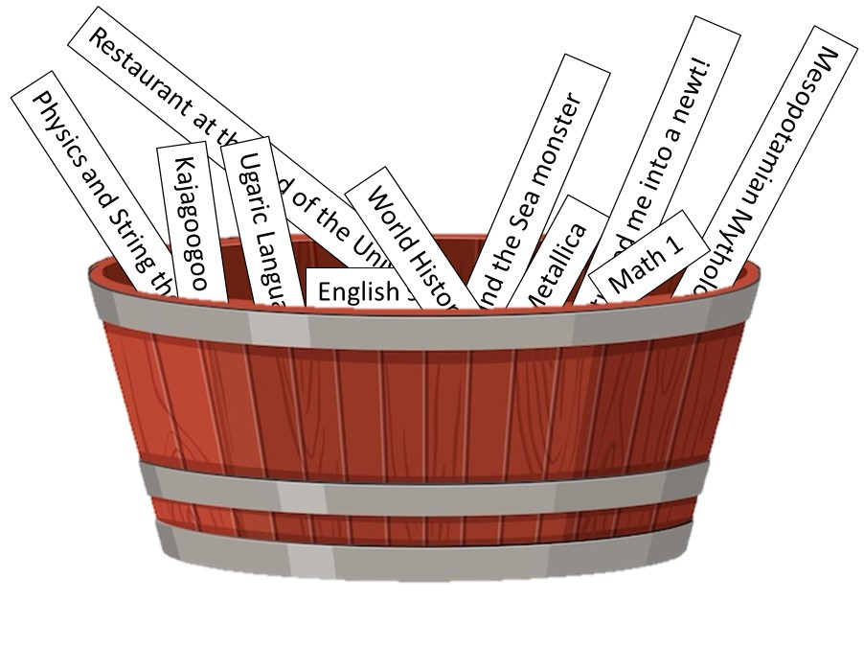
U1 Learning 01
Following Topics
Understanding
Math 3
Subject progress
Math 2
Math 1
Time
Staying within topic
Sociology topic
Things related to Sociology
Notes:
I do not learn things sequentially. I cannot filter the data into a logistical path. I literally pool everything into my head, and derive answers from that pool, regardless of the topic.

Slide 52
U2 Learning 02
Sigmund the Sea monster
Physics 4
English 9
Metallica
Ugaric Language
Math 1
World History
Mesopotamian Mythology
“And this is how I derived that Mount Vesuvius was glucose intolerant”

Slide 53

I’m typically not “following along”.
I’m absorbing.
Including deriving unique correlations and connections
Understanding
Time

Slide 54

Communication 03
What is supposed to happen
Communicate back
Interpret what I hear
Determine how to communicate response
Determine response
Grasp that I hear something
Including what words to use and what words to not use: what is proper to use based on the audience
Reads “body language”

Slide 55



Communication 03
I Hope to Communicate back correctly
Interpret what I hear
Determine how to communicate response
Determine response
Grasp that I hear something
Including what words to use and what words to not use: what is proper to use based on the audience
X
Reads “body language”

Slide 56
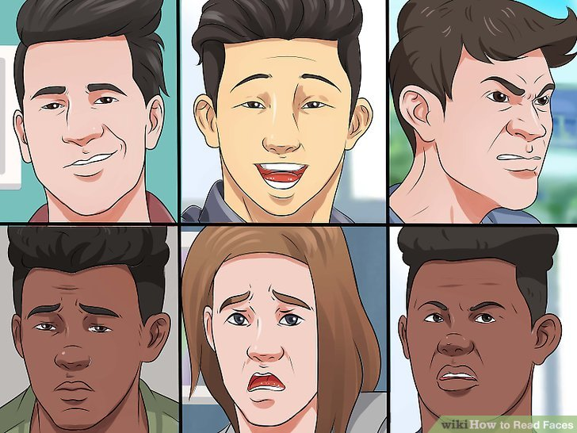

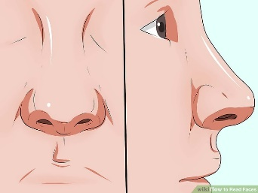
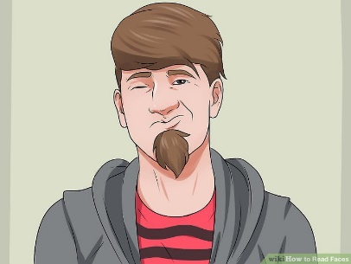


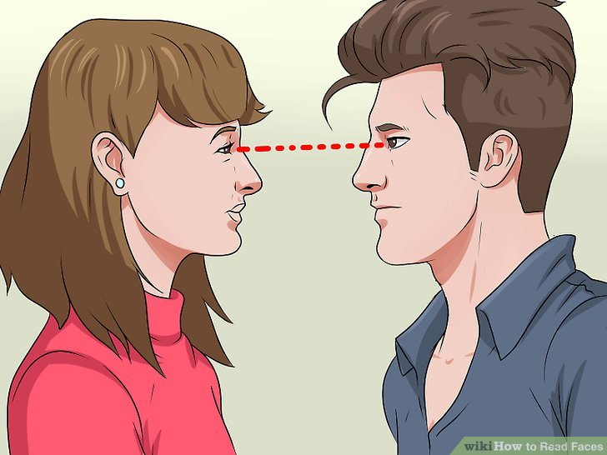
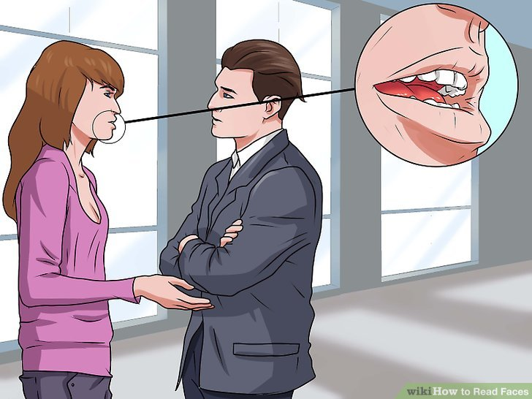
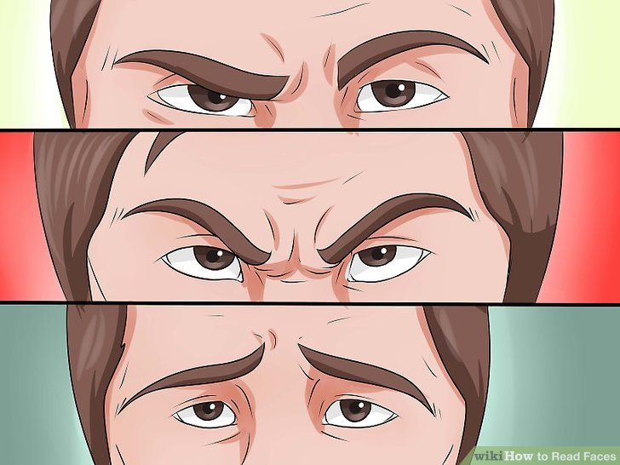
Basic ways it interfere with day-to-day interaction
The ability to read faces
The ability to understand social cues:
The ability to decipher innuendos and subtle hints/indirect “encouragement
people frequently read me wrong – usually as mad or discontent, even when I was fine.

Slide 57
Time 01
Time
End of the Week
4 Years in the future
2 Weeks ago
TODAY
Last Year
Yesterday
Tomorrow
Next Year
Yesterday
Tomorrow

Slide 58

Time 03
Time/Benchmarks
Long Hair
Next Spider-verse movie
TODAY
Took Piano Lessons
Semester Finals
?
Concert

Slide 59
E1 Filtering 04
Example in classroom/work
Teacher is talking
I hear Teacher talking

Slide 60
E1 Filtering 05
Example in classroom/work
Teacher is talking
Teacher talking
spinning fans, paper shuffle, fingers and feet moving, flickering lights distract me VISUALLY
The AUDITORY sound of air conditioners, mowers, people talking, static from intercom system, florescent lights, fingers popping and other noises are having a conversation with me
The agitation of anything TOUCHING my chair disrupts my focus
seams in my clothes irritate me
the moving air is annoying
changes in barometric pressure and humidity make me feel awkward/uncomfortable/on edge
various ODORS (cut grass, perfume, b.o., etc) interfere with my attention
changes in lights/ changing seats/ teacher changing locations disrupt my PERCEPTION
  causes me to have to recalculate my interpretation of where I'm at.
I'm not able to gate any of this out
All hits me at the same level of intensity

Slide 61
CC Learning 06
Instructions/procedures/stops/steps get lost in here
GOAL
1

Slide 62


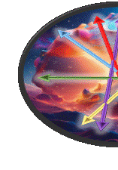
I “have issues” creating stopping points.
Ever try to stop someone on the spectrum mid process?
We need the opportunity to reach the goal
GOAL
1
GOAL
1

Slide 63
I do NOT handle stress well.
Communication becomes very hard when I am stressed.
I lose words and things become scrambled.
I have trouble reading or focusing.
I take time to process things (30 second. If I detect impatience…)

Slide 64

“punishment & reward” models use “you didn’t do it right/good enough”.
Example: grades
GOAL
?
Punishment
Reward

Slide 65
CC2 Learning 09
“Procedures” vs “Goal”
“Accomplishment” vs “Reward and Punishment”
“normal experimentation/gathering of data” → goal.
Place of School:
  More “what I want/end result”
  “here are the things to experiment with”
GOAL
Place of work:
  Here is what we have to use
  Here is the goal

Slide 66
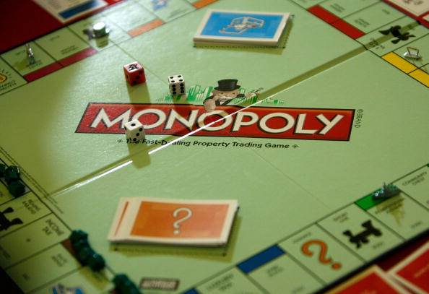

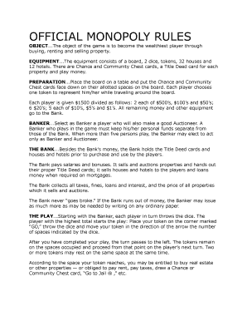
Learn through experimentation
The only limits are those which the environment imposes

Slide 67
CC2 Learning 09
How I learn the best:
I need to see the goal (or the opportunity to experiment to find it).
I need to see the tools I have.
  show me the equation/buttons/forms first before teaching it to me.
  Then teach me how the symbols work.
  Let me break it.
  I need the room to be able to experiment and learn – to strive towards “accomplishment”
    – Mistakes ARE the learning process.
    Grades to me were arbitrary at best.
GOAL

Slide 68
Job?
I am still overwhelmed by groups
I am still overwhelmed with new things
I don’t understand what is relevant
I have built personal games on different platforms
I build macros for Excel
I have an Information Systems BA…
I hate working in groups because no one understands me
I don’t handle stress well
I played bass in a metal band
I can’t wear ties
I’ve read tons of books on religion
I once wrote a book about a vampire based on the Asian concept of vampires
I’ve seen most of the early Manga series, which we used to call Japanimation
When I was young, we didn’t have computer manuals. We learned programs by experimentation
I can be slow learning new things, but I know how to learn new things, and push the boundaries
…

Slide 69
NN Last Notes 03
GOAL
I want a goal,
I want to feel that I have obtained that goal
  or was an essential part in obtaining that goal.

Slide 70
build portfolios of their skills.
get them involved in things that show their skills.
Help them understand how to convey relevant information (They don’t need to know your favorite episode of H.R. Pufnstuf)
They don’t need just a degree. They need a paper trail of the things they are capable of.
Example:
Jonathan has written several books, had theater training, and experience writing movie scripts.
Matthew has multiple Cyber Security certificates and has participated in “Capture the Flag”.

Slide 71
NN Last Notes 03
Eschatology
Plethora of:
Ancient religions
Middle eastern thought
Modern synergies
etc
Hermeneutics
Christology
Dogma
Literal vs
Dynamic vs Metaphorical
Exegesis
Interpretation
ecumenical diversity
Soteriology
Finding “A Truth” in here is impossible
Finding “My Truth” doubly so.

Slide 72
Hermeneutics
Interpretation
Dogma
I John 3:23
And this is God’s command:
To believe in His son, and
To love one another as he commanded us.
Interpretation
Exegesis
ecumenical diversity
Literal vs
Dynamic vs Metaphorical
Soteriology

Slide 73
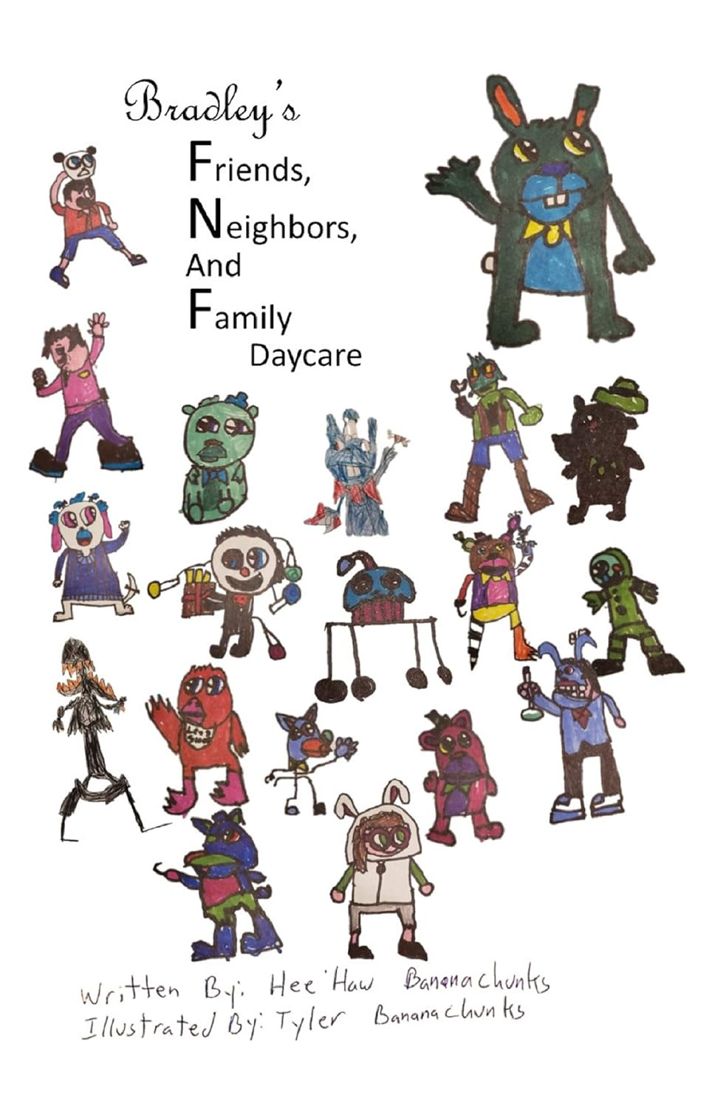
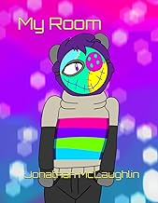




Slide 74




IBM Certs
Capture the Flag

Slide 75

DD Learning 12

Slide 76
Personal illustration
To show how fast students are registering after first day of registration
GOAL
Registration and Assessment:
6 Months and counting
Me building a working prototype
2 hours

Slide 77
Our goal should be constructive discipline.
  no free pass to do whatever.
  don’t want to destroy the spirit and the things that make growth unique.
Being strange and eccentric is fine.
Being destructive or abusive is not.
  We all have to come to grips with who we are and how we respond
Each individual, in the end, is the only one that can understand what makes them tick and how they need to cope. Part of their growing is understanding how they function, learn, work, and interact with themselves and others.

Slide 78

Research is Key:
Know yourself
& how you function.

Slide 80


QR Presentation
Grace Mosaic
Phloide.com

